Slide 1

The Noita Eye Messages
A Deep Dive

Slide 2
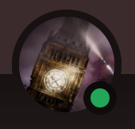
Who am I?
My name is Toboter
Part of the eye cryptography team for 3 years
Helped with several big discoveries
Managing an archival document

Slide 3
What am I doing here?
Summarising our main findings so far
Explain the thought process behind key discoveries
Provide an entry point for newcomers
Focus on cryptography (nothing about alchemy, search for ingame hints, etc.)

Slide 4
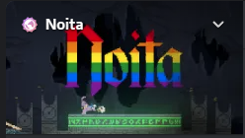
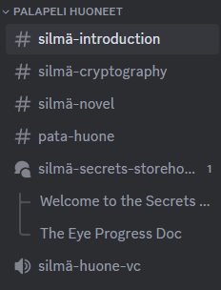
I want to help!
Join the Noita Discord! (link in description)
#silmä-cryptography for deciphering efforts
#silmä-novel for puzzle and ingame efforts
We’re looking forward to meeting you!

Slide 5
What messages?
Let me explain…
If you want to avoid spoilers for Noita, skip to:

Slide 6
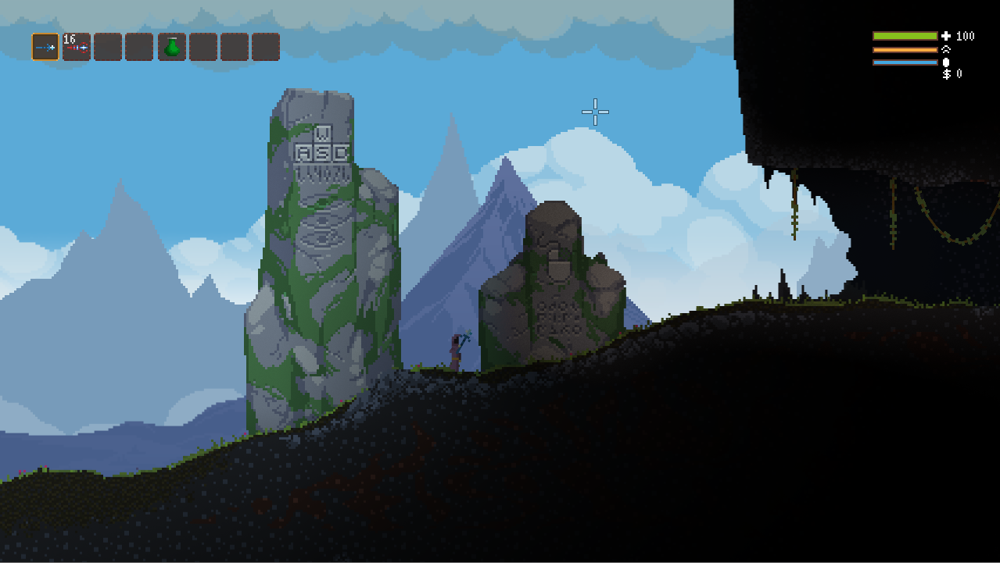
This is Noita!

Slide 7
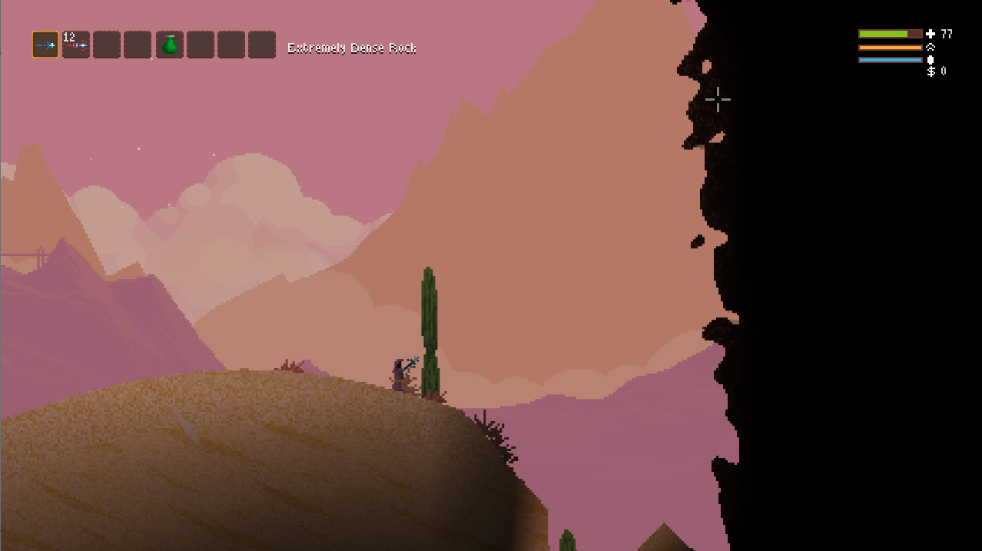
There’s a wall

Slide 8
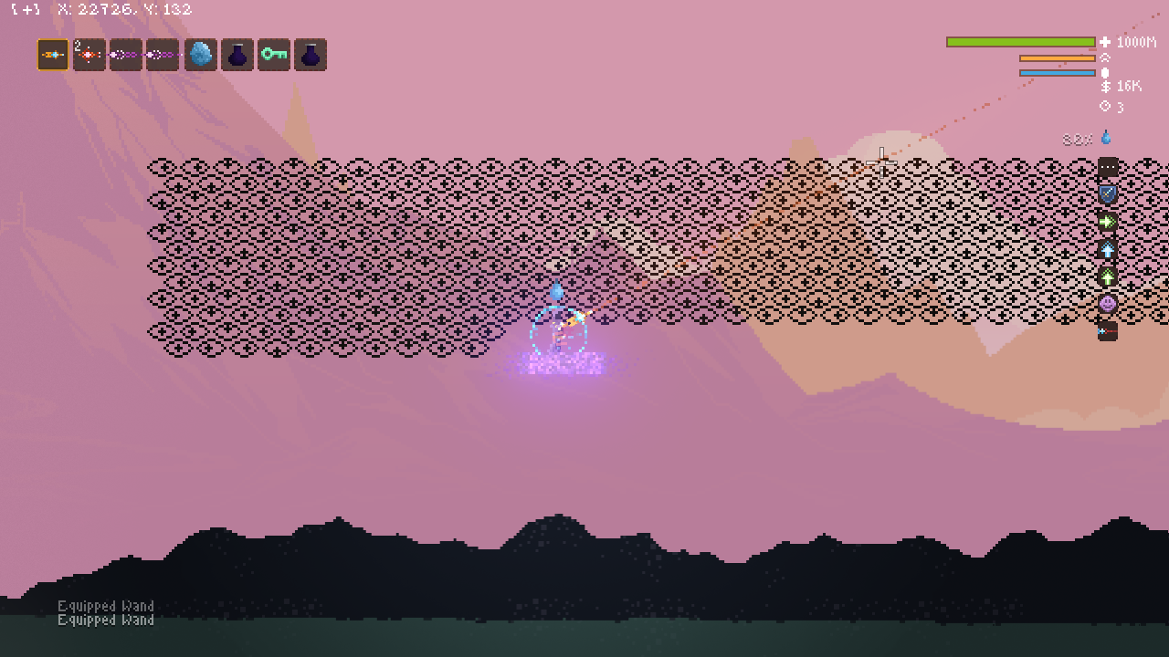
And beyond the wall are these

Slide 9
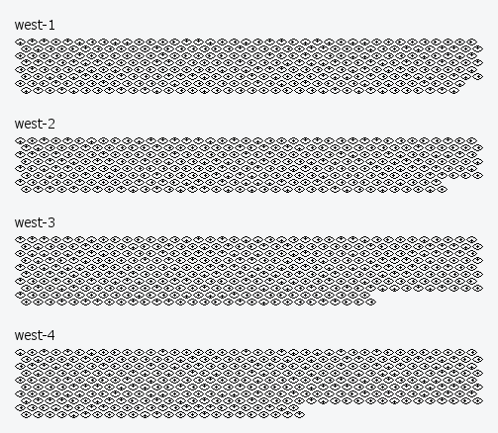
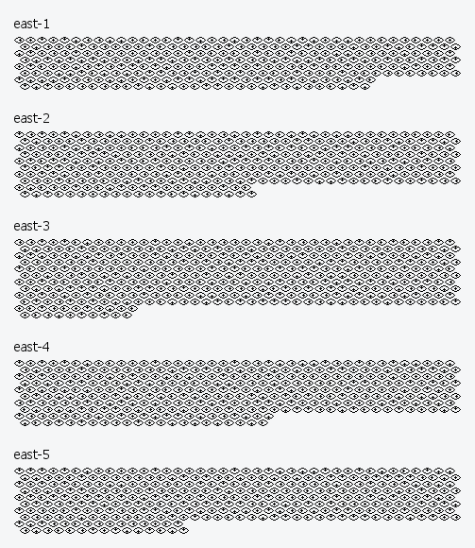
All the eye messages:

Slide 10
So how do we even start solving these?

Slide 11


Chapter 1: Trigrams
Three Eye is watching you

Slide 12
Initial observations
All Message lengths are divisible by three
All Messages end with
two irregular lines of eyes
Either slanted forwards or backwards

Slide 13

Conclusion
The eyes are grouped in interlaced triangles
For convenience, we call these trigrams

Slide 14
But what order to read them?

